Slide 1

Learn, Share & Grow: Become a Microsoft Learn Contributor
Alvin Ashcraft
Sr. Content Developer
Microsoft
Level: Introductory
Notes:
Welcome to this session on contributing to the documentation on Microsoft Learn.
I’ve given this presentation to some Microsoft MVPs on a call before last year’s MVP Summit. We wanted to prepare them for a pre-summit session where they had the opportunity to contribute to different product areas in the docs. It was well-received, so I decided to adapt it to present publicly to developers. It’s nearly the same material with some updates. I had to remove some internal metrics data.
So, let's kick things off!

Slide 2
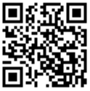
Session Survey
Your feedback is very important to us
Please take a moment to complete the session survey found in the mobile app
Use the QR code or search for “Converge360 Events” in your app store
Find this session on the Agenda tab
Click “Session Evaluation”
Thank you!

Slide 3
About Me
Software Developer & Architect for 25+ years
.NET / C# / WPF / Angular / SQL Server​
Morning Dew link blog – www.alvinashcraft.com
Daily links for developers since 2007​
Author of three books​ for Packt Publishing
Learn WinUI 3 (1st & 2nd editions)​
Parallel Programming and Concurrency with C# 10 and .NET 6​
Joined Microsoft in March 2022​ - Sr. Content Developer
Content team > Skilling > Ecosystems org​ > Cloud & AI (under Scott Guthrie)
Windows Developer Documentation (Win32 / UWP / Windows App SDK)​
TechBash Developer Conference
Organizer since TechBash 2016
TechBash Foundation - Founding board member (2015)

Slide 4



September 24-27, 2024 | Pocono Manor, PA
Amazing speakers with fresh content.
A fraction of the cost of the more crowded conferences.
- 3-day conference plus lodging for ~$1000
4th day of pre-conference workshops available.
Kalahari Resort Poconos – easy drive from major NE cities.
World-class keynote speakers.
In addition to the sessions, you get a great hallway track, amazing food, attendee Welcome Reception, Game Night & more!
Family Day Friday - full day of kids' sessions, free for attendees' families.
Discounted hotel rooms with free water park access: stay, learn & play all week!
Info: techbash.com or @techbash
Call for speakers: sessionize.com/techbash-2024/
Notes:
Our next event, TechBash 2024, is coming up in September.
It’s a conference at the Kalahari Resort in the Poconos with 3-day and 4-day options. We have an awesome time every year. It has the food, speakers, and content of a big event like VSLive or Microsoft Build with a size of a large code camp or other regional conference. You can bring your whole family for the water park, Thursday Game Night, and our Friday Family Day sessions for kids.
Early bird registration opened earlier this month and ends on May 21st.

Slide 5
Agenda
Introduction to Microsoft Learn
Learn Tips & Tricks
Docs As Code in GitHub
Learn Documentation is Open Source
GitHub Workflow
How to Contribute
GitHub issues and Docs Feedback
Submit a PR for Simple Changes
VS Code & the Learn Authoring Pack
Resources
Q&A
Notes:
As for today's agenda...
We'll start with an overview of Microsoft Learn.
We'll review some tips and tricks for navigating and using the various features on the Microsoft Learn documentation pages.
We’ll see how our teams at Microsoft create docs as code in GitHub. Yes, the content on Learn is open source on GitHub.
We'll review the typical GitHub workflow.
Next, we'll see how you can contribute to Learn with GitHub issues and PRs.
Then we’ll see how writers on our teams use VS Code and the Learn Authoring Pack of extensions to create content for Learn.
We’ll try to leave some time at the end for some Q&A, but feel free to ask questions as we go along.

Slide 6
Introduction to Microsoft Learn
Documentation – https://learn.microsoft.com/docs
Training – https://learn.microsoft.com/training
Q&A – https://learn.microsoft.com/answers
Notes:
We’re part of the Microsoft Learn team, internally we belong to the Skilling org within Cloud & AI. We support tens of thousands of articles and training modules.
There are many content teams on Learn, working on different product areas. What we'll talk about today applies to all the docs on Microsoft Learn, for all technologies.
The Learn site consists of documentation, training modules, and Q&A forums.

Slide 7
Microsoft Content Development Teams
Create documentation & training modules
Introductory to expert level guidance and reference docs
Code Samples
Community interaction
Bugs, suggestions, feedback
Technical background
Strategic advantage
Enhance adoption
Technical marketing
Notes:
As I mentioned, there are many content teams in our org, concentrating on different product areas on Microsoft Learn. We have content teams for all the products that you're familiar with.
Through Learn, we provide access to documentation, samples, and training, and we foster community interaction through Q&A. We accept bugs, suggestions, and feedback, and we want to connect with you.
The product teams at Microsoft view Learn as a means of educating users, enhancing product adoption, and as a means of technical marketing. Although many of them still call it MSDN.

Slide 8
Learn Tips & Tricks
Get to know the Microsoft Learn site
Notes:
Let’s get familiar with the Learn site with a few essential tips and tricks.

Slide 9
Demo: Learn Tips & Tricks
Saving to Collections
Feedback and edits
Searching content
Navigating documentation pages
Save copies offline
Working with versioned content
Notes:
Learn tips & tricks demo.
Cluster of buttons at the top of the content:
The Plus button - Allows you to save links to collections. This can organize docs into groups that you might be using for a specific project or certification exam. You can save docs to a collection alongside training modules and Q&A pages to gather your materials into one place.
Pencil button - Ab edit button that helps you start a new PR, and that is something we’ll talk about in detail shortly.
The dropdown button with three dots provides sharing options.
The feedback button pops open a feedback entry dialog. You can also scroll down to Submit feedback options at bottom of the page.
Two search boxes on the page:
First, at the top-right, you can search the entire Learn site. From that results page, you can filter your search based on technology, content type, etc.
The other search box is on top of the table of contents on the left. The TOC includes many different articles for the product, and it’s here you can search titles inside a given Table of Contents. You might find that more convenient than a wider scoped search.
At the top of each article, you’ll see a navigation for the article’s major headings. (In this article)
All article header links are reflected in the URL when clicked. It’s handy you want to send a colleague a link to a specific heading/section. You can also hover on a heading, see the link graphic appear, and copy the URL with the page anchor appended.
Bottom left-hand corner of the page (below the TOC - the Download PDF option.
Monikers - Where it makes sense, the same doc might include different information for different versions of the product mentioned:
We may use the same article with various versions of content for different versions of a product (Windows SDK versions, .NET versions, SQL Server versions, etc.)
We can enclose markdown within "moniker" blocks to show different content for different versions, depending on what is passed in the URL query string parameters. If something doesn’t look right on a page, look at the selected version.
Can affect the Table of Contents by including or excluding certain articles.
Handle versioning via tabs inside the document, or clearly state the versions in the Applies To row at the top of the article or use colorful Note boxes throughout to make sure you know what version of Windows or .NET the content covers.

Slide 10
How to Contribute
Issues, Pull Requests, and Feedback
Notes:
So, how can you contribute to Microsoft Docs? For documentation issues, use either:
1. GitHub Issues
2. Git Pull Requests, just as if you were contributing to any other open-source project.
Contributing can be done easily through the browser. You don't have to learn git bash or other tooling. You don't need to install anything. The browser workflow allows you to contribute without having to know what a fork, clone, push, or pull is. We’ll demo that process later if you’re unfamiliar.
If you already work with Git or GitHub and are familiar with pull requests and remote repositories, you can do that, and later we’ll also talk about how this process works behind the scenes.
We know that a lot of folks in many of our product areas aren’t familiar with Git, and that’s not a problem! Anyone can help, easily, using only your browser.

Slide 11
Anyone Can Contribute
Edit content for the entire community
Contributors listed on top of each article
High monthly pageview count
Contribute to Learn entirely in the browser
Docs as Code
Get started: learn.microsoft.com/contribute
Notes:
If you're new to contributing to Learn, we have a step-by-step tutorial in our Contributor's Guide at this URL here to guide you through the process of creating a PR.
By contributing to Microsoft Learn, you can be a part of the community and help edit docs that everyone uses.
We’ll talk about the contributor designation displayed on the top of every article. We have a significant number of pageview across the Learn site.
You can do this entirely in the browser if you want, with nothing to install.
You’re about to get an inside peek at the process behind Microsoft’s Documentation as Code approach.

Slide 12
What Belongs in Issues & PRs
For support issues, contact Support or partner.
For Azure product ideas and product feedback, use feedback.azure.com.
For Windows product feedback, use the Feedback app in the Microsoft Store.
.NET has their own support options: dotnet.microsoft.com/platform/support.
Learn feedback should address the documentation.
Notes:
Let's start by discussing when to create an Issue or PR.
To be clear, support issues don’t belong in document feedback. The feedback options we’re about to discuss are not Microsoft Support and has no SLA for response time for most Learn teams (although the .NET docs team is working on providing an SLA for their GitHub items). If you’re having a problem or unexpected behavior or an outage, contact Microsoft Support or your support partner. We triage incoming issues and PRs from GitHub and if it sounds like a support issue, your issue will likely be closed with a polite message and some links to Microsoft Support or the Q&A forums.
For Product Ideas and product feedback, Azure products have a dedicated site for this. You might remember the Connect items or UserVoice systems of the past, that has been replaced by a new system hosted at feedback.azure.com. Feedback.azure.com hosts product feedback channels for many Microsoft products and technologies, including SQL Server.
Windows collects product feedback through the Feedback app, available in the Microsoft Store, and the .NET team has a dedicated site with support options listed.
The .NET team has their support options listed on a dedicated site at this URL.
Most documentation issues that get attention are a request to fix something missing or outdated or wrong, or a request to add something that would have helped prevent some kind of error.

Slide 13
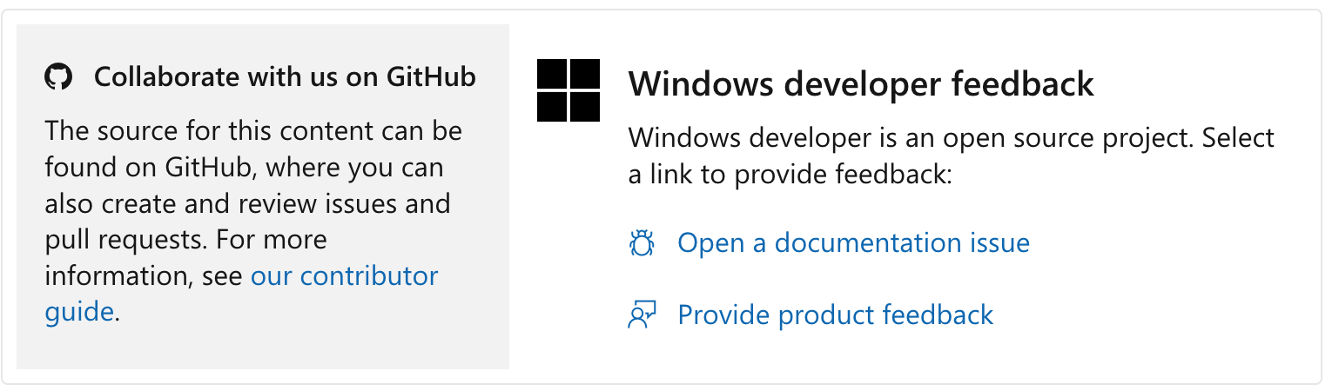
Contribute via a GitHub Issue
GitHub Issue: Open a documentation issue.
github.com/MicrosoftDocs
Notes:
So, let’s say you know you’ve got a documentation issue to suggest. Think of this as letting us know: "Something’s wrong with the docs here. Please fix it."
We have goals to address these issues in a timely manner, but issues are triaged and can sometimes take days or weeks to get a satisfactory resolution. We will sometimes close an issue, noting that we have created an internal work item to address the issue and later circle back to leave a comment when it's been resolved.
Not all issues become a documentation change.
To create an issue, use the “Open a documentation issue” link that we saw at the bottom of the article during the demo.
Some areas of the docs have moved to a new feedback experience that does not involve GitHub. This is primarily being done in areas where users are not likely to be developers or have a GitHub account. Our org is trying to remove “having a GitHub account” as being a barrier to entry. In those cases, you will use the Feedback popup that we saw earlier. The downside to this experience is that there’s currently no way to provide contact info, so we can’t follow up if we have any questions about your feedback.

Slide 14
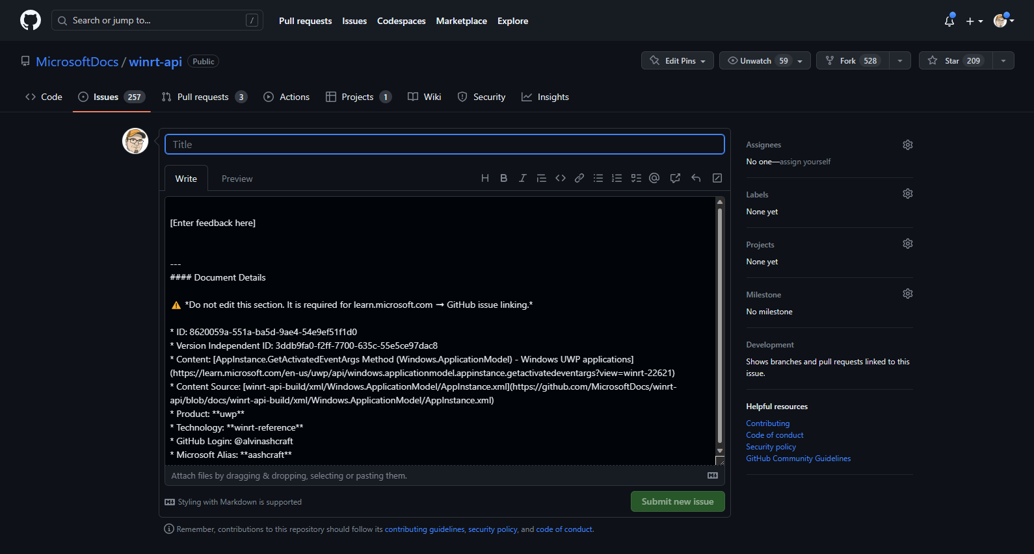
Filling in the Issue Details
Notes:
Here’s the screen when you open a new issue on GitHub. You just add your comments in the large textbox here (markdown is supported), give it a meaningful title, and hit “Submit new issue”. We’ll take it from there.
When it comes to submitting issues, more details is always better.

Slide 15
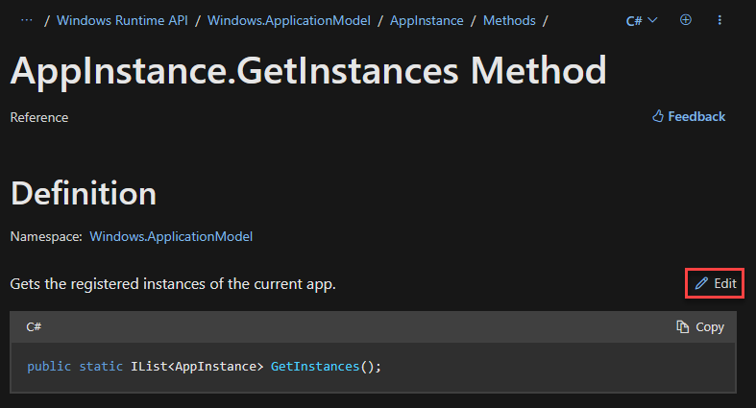
Contribute with a GitHub Pull Request
Make your own simple edits with a Pull Request (PR) through GitHub
Notes:
The second option for contributing to docs is the pull request.
You’ve got a documentation issue, and you want to suggest the edits yourself; you can click on the “Pencil” button that we saw earlier in the top right-hand corner.

Slide 16
Demo: Create a PR
Edit an article
Working with markdown
Preview your changes
Create a new PR
The PR review process
Additional commits and suggesting changes
Notes:
Create a PR demo.
Clicking the Pencil button on top of a doc brings you to the GitHub preview page for that article. From here, click the Pencil button on the top right of the header bar.
After you click the Pencil button in GitHub, you will be looking at the actual markdown code in a text edit box.
Microsoft Docs are not edited Microsoft Word documents, but rather in code, in markdown or yaml. Markdown is a lightweight text markup language created for formatting rich text with a plain text editor. GitHub has their own formal implementation of markdown called GitHub-Flavored Markdown. Many different online sites use markdown for their content, including GitHub, GitLab, Reddit, Stack Exchange, BitBucket, Drupal, and more. Even Microsoft Teams allows some basic markdown in chat.
Make your changes here in the text box. If you’re not familiar with markdown, it’s easy to understand once you get rolling, and don’t worry about your PR being perfect. The Content Team will always review your content submission and potentially tweak it to Microsoft standards before it is merged. There are plenty of resources online for basic markdown syntax, but if you don’t get something quite right, don’t sweat it.
You can use the Preview changes feature to preview the raw markdown formatting.
Once you’ve made changes, scroll to the bottom. Here you can propose changes by committing your changes to your own branch.
Enter your PR title and comments. Include why you’re proposing the changes and if you have any specific parts of the changes that you’d like feedback on.
If you’re not familiar with GitHub terminology like pull requests, don’t worry, you don’t have to be! Once you click the green “Propose changes” button, we’ll take it from here and keep you updated as your new Pull Request moves through the process.
Your changes to the markdown file will be proposed for merge, triaged, and reviewed by the article’s author (or current owner) and potentially additional reviewers. The content team for the article takes it from there, replies in the PR comments, makes further edits if necessary, and eventually decide whether to merge your changes. You’ll be notified with feedback directly from one of us on the content team.
Again, you can do all this if you want through your own tooling, to create your own fork, branch, commits, push your changes, and create a PR. That’s what writers on the Content Teams do every day. But if you want to just use GitHub to handle the entire process for you, it’s much easier for simple changes.
Here’s what it looks like after you’ve submitted your pull request.
Your PR will start in an Open status. We can look at one that is already Merged. Once it’s merged, it’s been accepted and soon will be sync’ed to the production repo and deployed.
You can see what GitHub did for you was to automatically in the background create a fork, create a branch in the user’s name. So, we would have a branch named something like username colon patch-399 as the name of the working branch in the user’s repository.
The pull request includes the commit, which is in the PR log. Pull Requests can potentially include many commits for multiple files.
The PR log contains both automated and manually created messages, automation for the merge engines, all commits, and conversation and notes from anyone assigned. Eventually, someone on the content team may sign off on the change and have it merged, and you’ll see those comments too. You’ll receive an email anytime anyone uses your username with an @ symbol, and you can respond in conversation at the bottom here with the comment button.
After your PR is created, both you and Microsoft can review the changes you’re suggesting in the Pull Request.
Click on the “Files Changed” tab to see an in-browser diff. Red is the old code line, green is the new, and the changed characters are highlighted.
In fact, you may find creating a GitHub Pull Request easier than creating a Git Issue. If you’re trying to describe how something should change, simply making the change yourself is sometimes easier than trying to describe the issue accurately and clearly. You'll still want to provide a description of why you're making the changes.
If you still want to make more changes to the file, you can issue another commit to the pull request, simply click on the three dots icon here and click Edit file. Edit the same file or other files in your working branch, then you can submit another commit to the same branch, and it will be included in the same open pull request.
After you’ve submitted your PR and you’re happy with the changes, you can sit back. We’ve got it from here and will let you know if we have more questions or a status update.
You can also use GitHub to contribute edits to others’ work. In the Files Changed tab of a PR, where you’re reviewing the line-by-line changes, click the blue plus button on any line number of changed code. You can make comments and start discussion on any changed line. You can also make suggestions, directly in line! Click the “Add a suggestion” button that looks like a plus-minus box. Now you’re editing the line or lines you’ve selected with the blue plus button. You can then submit this change to the actual author as a single comment, or you can click the green “Start a review” button to make many different suggestions and comments and submit them all at once. You can even use this on your own PRs to discuss changes and comments with your reviewers and make commits in-line. You might see us making suggestions or changes this way too.
All this makes it easy to collaborate with doc authors and reviewers entirely within GitHub.

Slide 17
Contributions: Wrap-Up
GitHub Issue – suggest changes or report a problem
Feedback – anonymous feedback, no follow-up
PR – contribute directly to articles
Guidance: https://learn.microsoft.com/contribute
Notes:
So, there you have it. We saw two ways you can contribute to Learn.
Now, what’s most helpful for Microsoft, and what’s gives you contribution credit on the Learn site? Only a Pull Request. That’s what we want to see.

Slide 18
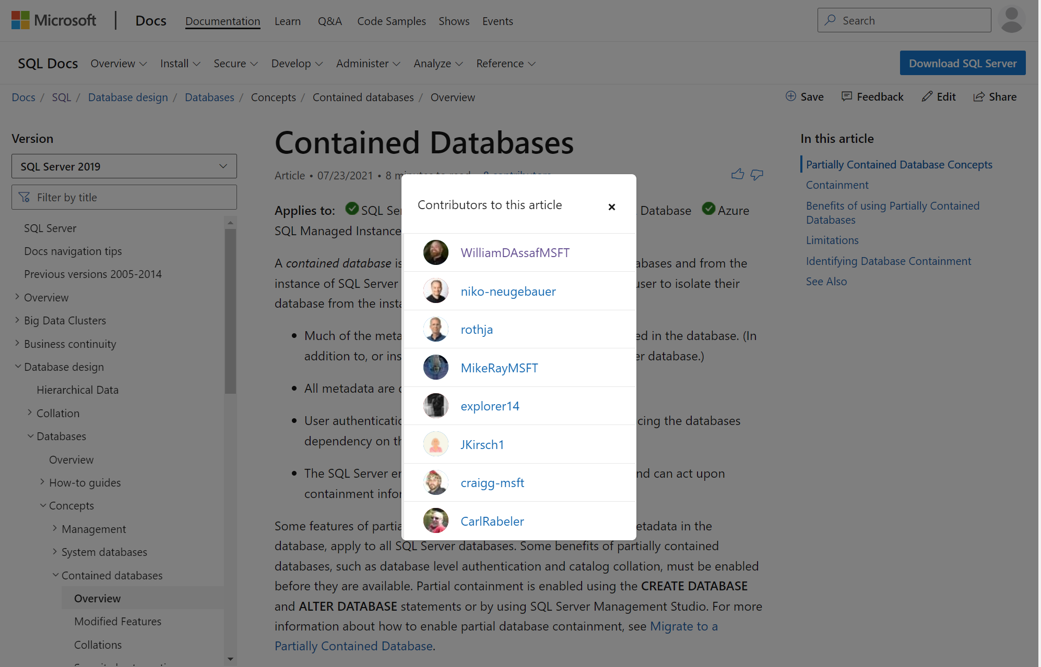
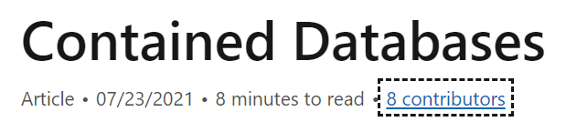

Credit Due!
Notes:
If you contributed via a Pull Request, and we merge your commit into the document, you’ll get mentioned in the ‘contributors’ popup, with your GitHub profile pic and a link! The folks listed here are both inside Microsoft and external contributors who had commits merged to an article.
You only get your name and avatar on an article for a Pull Request, not for an issue. It's also worth mentioning that if you start a PR, even if we close it and pull in your commits with a different PR, you would still be recognized here.

Slide 19
Stop Worrying & Love the Pull Request
If you're not sure how it should change, give it a shot.
Image or graphic needs to be updated? We got it.
Capitalization is Tough. We get it.
“Azure SQL Managed Instance” vs “a managed instance”
“Azure Functions” vs “a function”
When you go to Taco Hut, you eat a taco, not a Taco.
Above all, be simple and human.
Get Help - https://learn.microsoft.com/Contribute/content/
Notes:
When it comes to PRs... If you're not sure how it should change, just give it a shot. If it’s not quite right, or formatted perfectly, don’t worry! We’ll adjust, but at least it gets fixed! Don’t be afraid to submit a pull request. Here’s some other notes to ease your anxiety and put you at ease.
For images, graphics, charts, etc., we have designers at Microsoft that we use to get images updated in a standardized way. No need to edit images yourself, though you could make suggestions to image updates along with alt text changes within the markdown, for example, via a Pull Request.
Also, we get it, capitalization is tough. The capitalization of various features and products inside Microsoft is one of the most nuanced bits there is about publishing. Marketing usually wins these arguments.
For example, product names and feature names and phrasing are difficult to get just right and are trickiest when a generic word is in the product name. Just because we have a product called Azure SQL Database, doesn’t meant that every word Database is now capitalized. Azure SQL Managed Instance the product, versus, a managed instance. Or the product Azure Functions, versus, a function. Try to remember that when you go to Taco Hut, you eat a taco, not a Taco.
This is even more difficult for our international partners and customers, because capitalization often means a product or service name shouldn't be translated or should be translated in a specific way, but lower-case common noun of the same term should be translated. Translation is difficult enough, so it’s important we get this right, and inconsistency in capitalization confuses translators and customers.
Finally, consistency is important, and so are the core goals of our brand voice: Above all, be simple and human. If we can do better to meet that goal, let us know!

Slide 20
GitHub Hosts Microsoft Learn Content
Public and Private Repos
Notes:
So, now that you’ve seen how you can use GitHub to contribute to documentation Learn, let’s briefly show you some inside info and discuss how we use GitHub to host Microsoft Documentation.

Slide 21
Learn Behind the Scenes
Visual Studio Code, Learn Authoring Pack, GitHub, Azure DevOps
Rich metadata and SEO tracking, Azure Databricks
Release branches for big, timed doc releases (think Build & Ignite)
Notes:
Again, most Microsoft Learn pages are edited in markdown. We spend most of our time using Visual Studio Code to edit them. We have other tools to help with automated link checking, syntax formatting, bulk updates, and a series of include files to tokenize things like product names.
We have a rich set of metadata for each article. We do pay attention to how articles perform in terms of Search Engine Optimization and traffic patterns and trends, all driven through Azure Analytics and Databricks. We try to improve poorly performing articles. We use many metrics to track the performance of an article including things like when you copy text from the article, that’s good! Or if you click through, scroll, dwell, the same kind of metrics that any website uses these days to measure how effective the web page is. We do all this without capturing any personal information or wider tracking information. Most of our decisions with documentation and docs layouts are data driven, when we we’ve driven better engagement and more useful docs, we try to follow that lead.
For big article updates we have systems to handle release branches – for when we want to work on documentation for months and then release a new product or feature all at once, like during an Ignite or Build keynote. Many of these strategies are similar to what developers use to release software all at once, and we use many of the same tools.

Slide 22
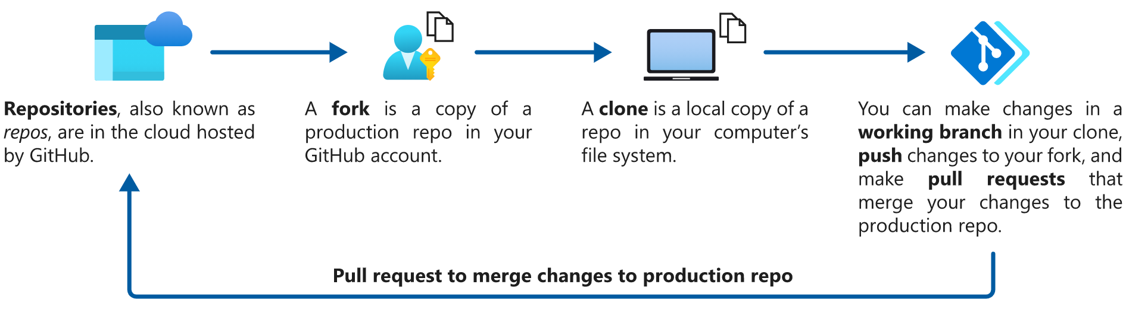
GitHub Basics
A more detailed GitHub workflow:
https://github.com/PowerShell/Community-Blog/blob/main/Docs/GitHub-workflow-for-new-post.md
Notes:
This is behind the scenes of how Microsoft Docs works in GitHub, where all Microsoft Documentation is managed. If you are new to Git and don’t understand this don’t worry, as we’ll explain, to contributors in the community, all this is managed for you when you use the browser workflow.
Here’s the basic GitHub Workflow.
Hit this link at the bottom for a more detailed GitHub workflow diagram.

Slide 23
Learn Resources for Git & GitHub
Learning paths for foundational GitHub knowledge
https://learn.microsoft.com/training/github
Introduction to version control with Git – Training
https://learn.microsoft.com/training/paths/intro-to-vc-git
Use Git version-control tools in VS Code - Training
https://learn.microsoft.com/training/modules/use-git-from-vs-code

Slide 24
VS Code Extension for Authoring
Learn Authoring Pack
Enhanced markdown preview optimized for Learn
Markdown linter
Article templates
YAML schema validation
Learn images extension
GitLens
Enhanced commit history with visualizations
Comparison commands
GitHub Pull Requests and Issues
Review & manage issues and pull requests within VS Code
GitHub Copilot
Markdown suggestions as you type
Notes:
When authoring markdown content, most content developers in our org use Visual Studio Code and the Learn Authoring Pack plugin bundle.
The Learn Authoring Pack includes several plugins to streamline writing markdown for Learn. You can see a few examples here.
There are some other Git and GitHub productivity plugins available for VS Code, like GitLens and the GitHub plugin for PRs and Issues. When it comes to VS Code plugins, you should use what your comfortable with.

Slide 25
Demo: How We Work
Learn Authoring Pack
Working with Markdown
Markdown Preview for Learn Content
Preview Content in Branches with Private Repos
Public & Private Repos – GitHub & Azure DevOps
Notes:
Demo stuff to cover:
The Visual Studio Code Learn Authoring Pack
Markdown basics
Docs markdown pages – metadata header and common sections
API ref content vs “conceptual” content
Preview pane styled for Learn
Working with branches and the review.learn.Microsoft.com
Working with internal and external repos

Slide 26
Additional Resources + Q&A
Wrapping up with some links and questions!
Notes:
We’ll round things out by looking at some additional resources when working on documentation on Microsoft Learn.

Slide 27
Links galore!
Contributor Home: https://learn.microsoft.com/contribute/
Contributor Guide: https://learn.microsoft.com/Contribute/content/
Microsoft Writing Style guide: https://learn.microsoft.com/style-guide/welcome/
Contributor Training Module: https://learn.microsoft.com/training/modules/contribute-to-docs-browser/
Learn Authoring Pack Info: https://learn.microsoft.com/contribute/content/how-to-write-docs-auth-pack
Microsoft Docs GitHub Org: https://github.com/microsoftdocs
Notes:
The Microsoft Learn contributor home is your gateway to learning all you need to know about contributing to our docs.
The Contributor’s Guide is our documentation about contributing to documentation (and training).
The Microsoft Writing Style Guide provides guidance on writing in the docs.
We also have a training module you can take to learn more about contributing.
We’ve talked about the Learn Authoring Pack. The link here is a link to its documentation.
All of the public Learn repos are created in the MicrosoftDocs org in GitHub. You can browse them here.

Slide 28
Thank you! Questions?

Slide 29
Session Survey
Your feedback is very important to us
Please take a moment to complete the session survey found in the mobile app
Use the QR code or search for “Converge360 Events” in your app store
Find this session on the Agenda tab
Click “Session Evaluation”
Thank you!

